Slide 1
Microscope photo comparison

Slide 2
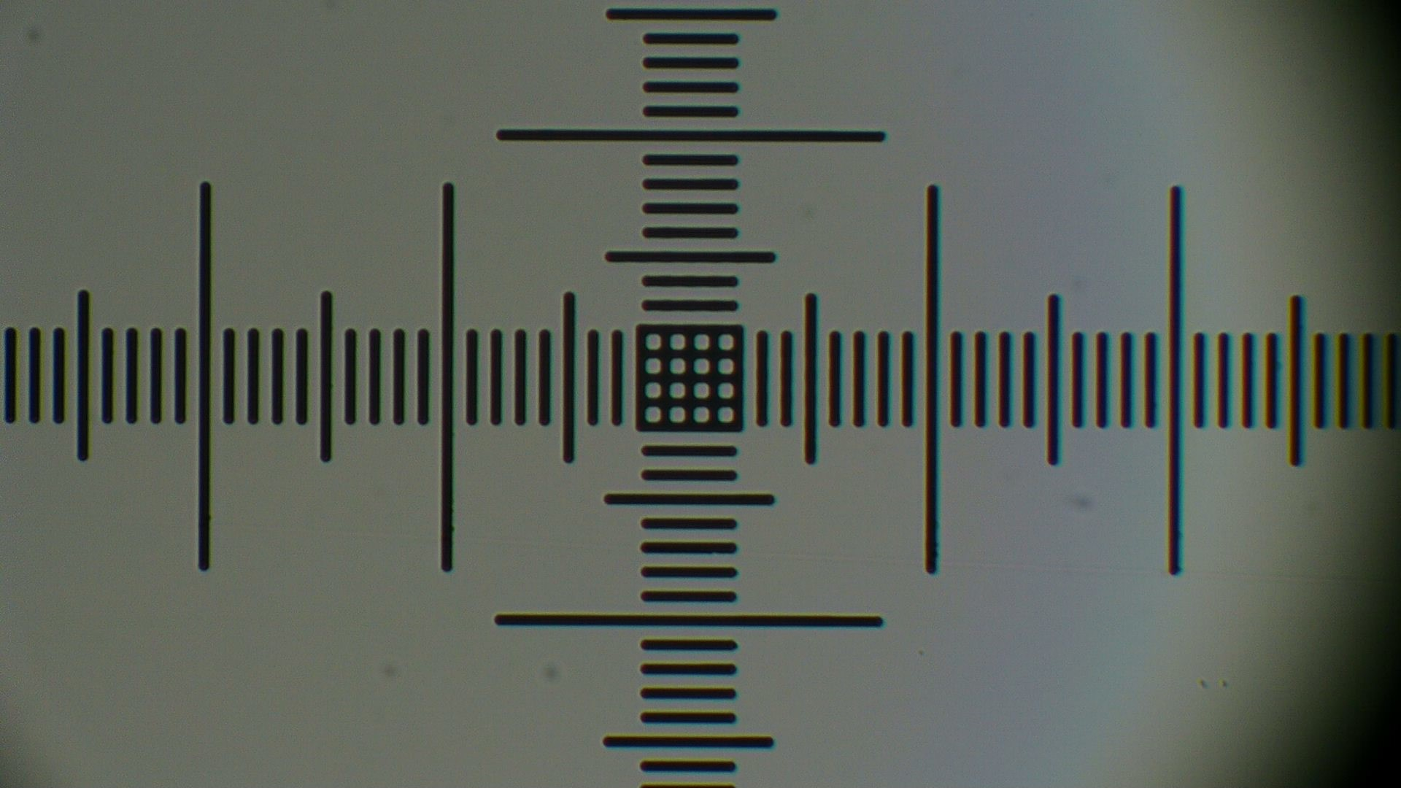
Omax Microscope 100x
calibration slide

Slide 3
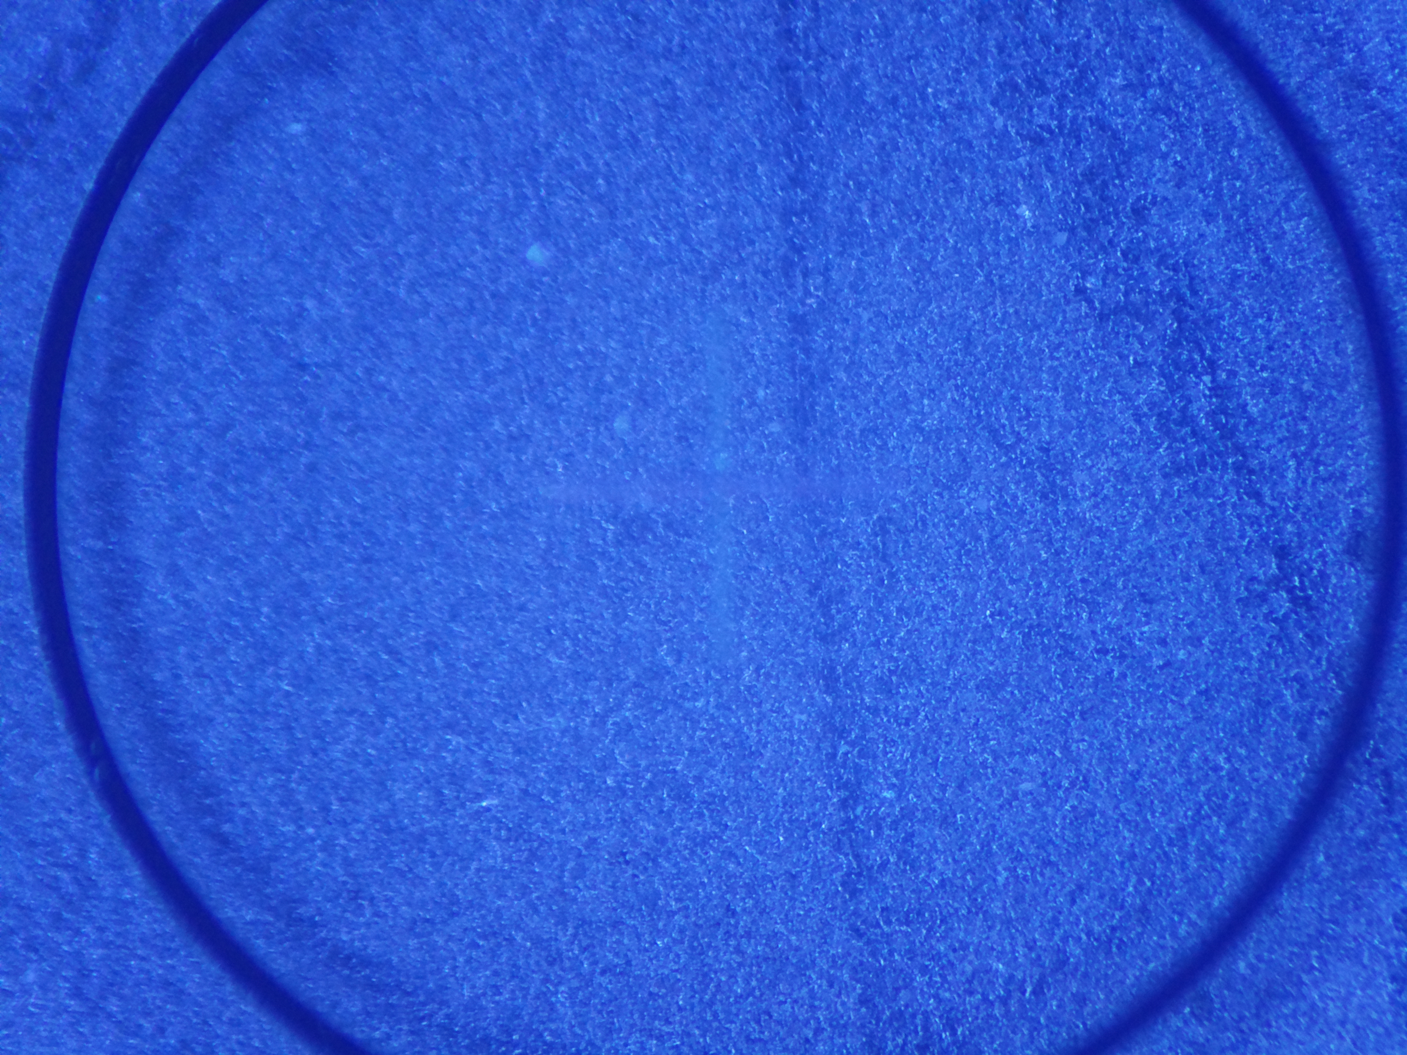
RaspPi HQ 300x crosshair ruler

Slide 4
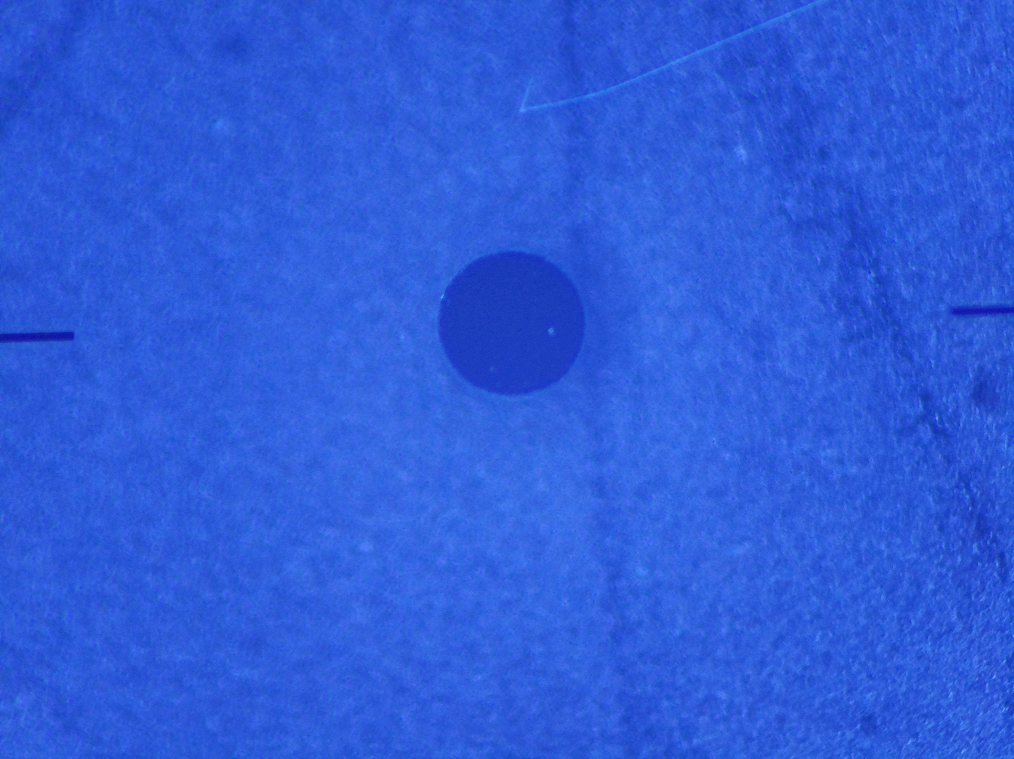
RaspPi HQ 300x 0.6mm dot

Slide 5
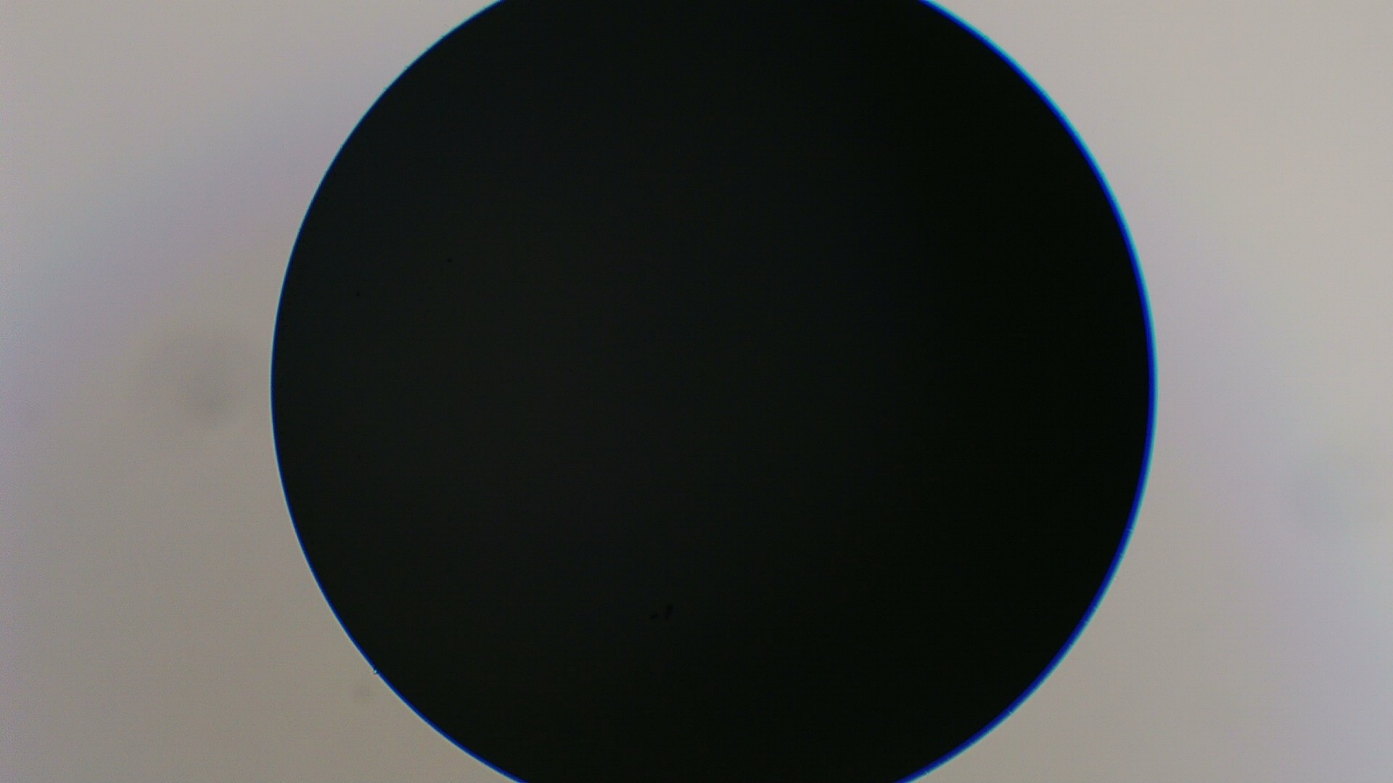
Omax Microscope 100x
w/0.5 adapter, calibration slide 0.6mm dot

Slide 6
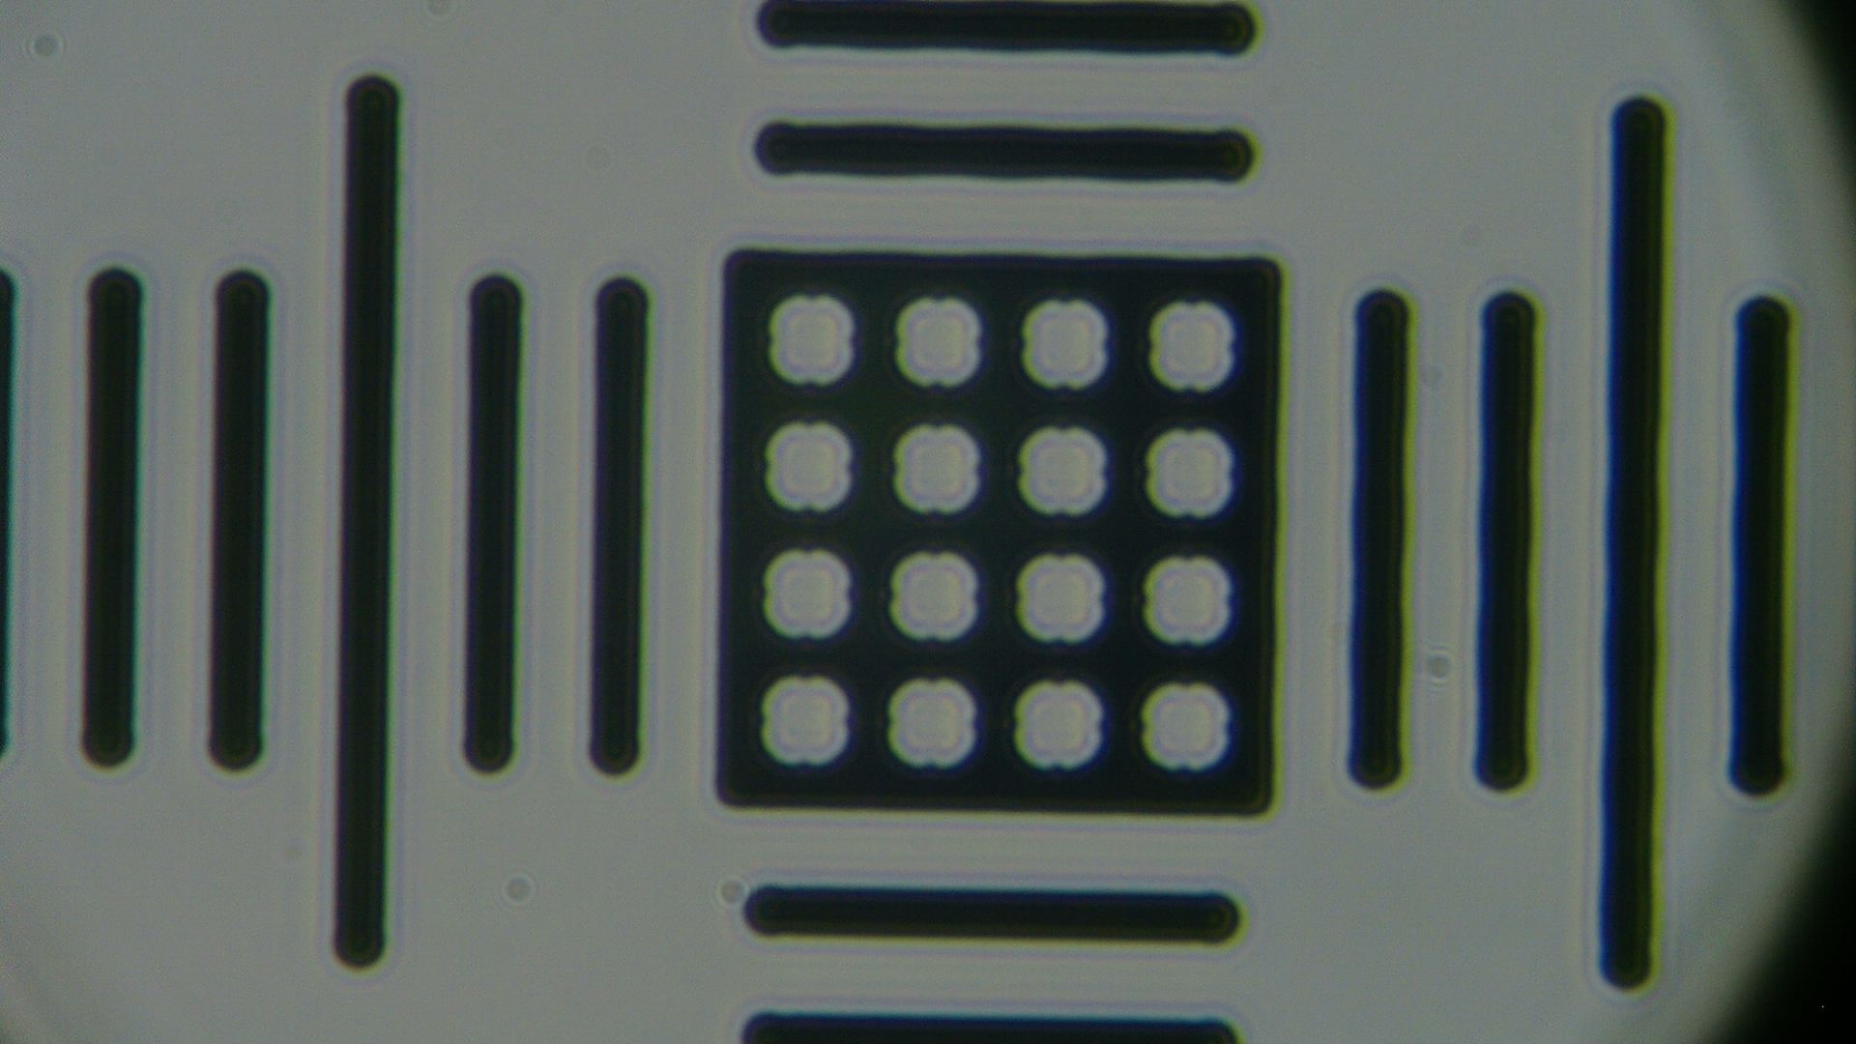
Omax Microscope 400x
calibration slide

Slide 7
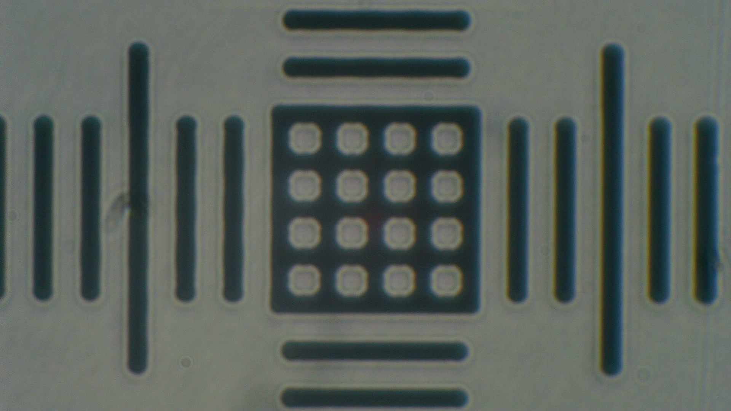
Omax Microscope 600x
w/0.5 adapter calibration slide

Slide 8
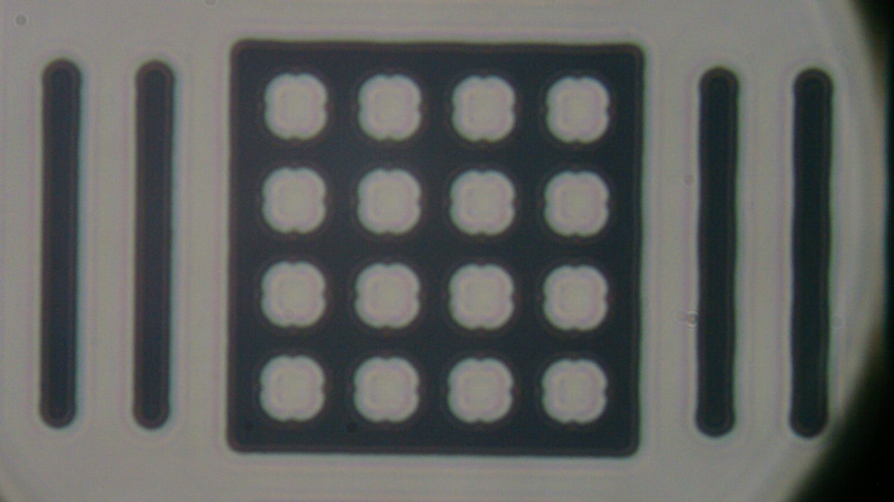
Omax Microscope 600x
calibration slide

Slide 9
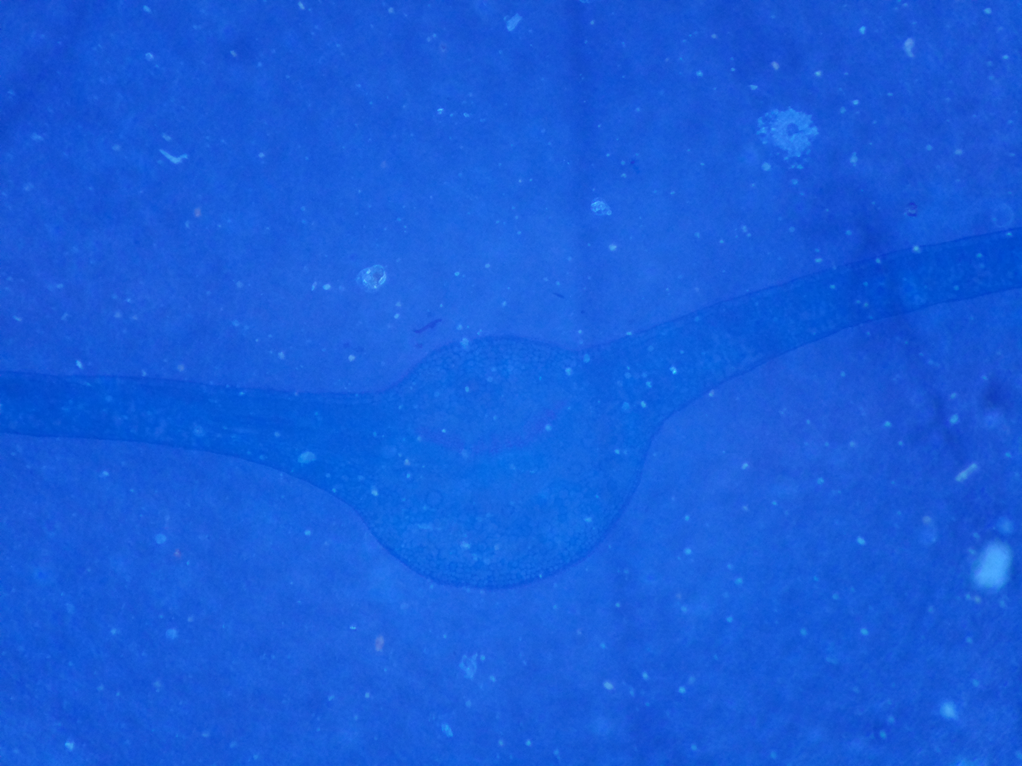
RaspPi HQ 300x plant cells

Slide 10
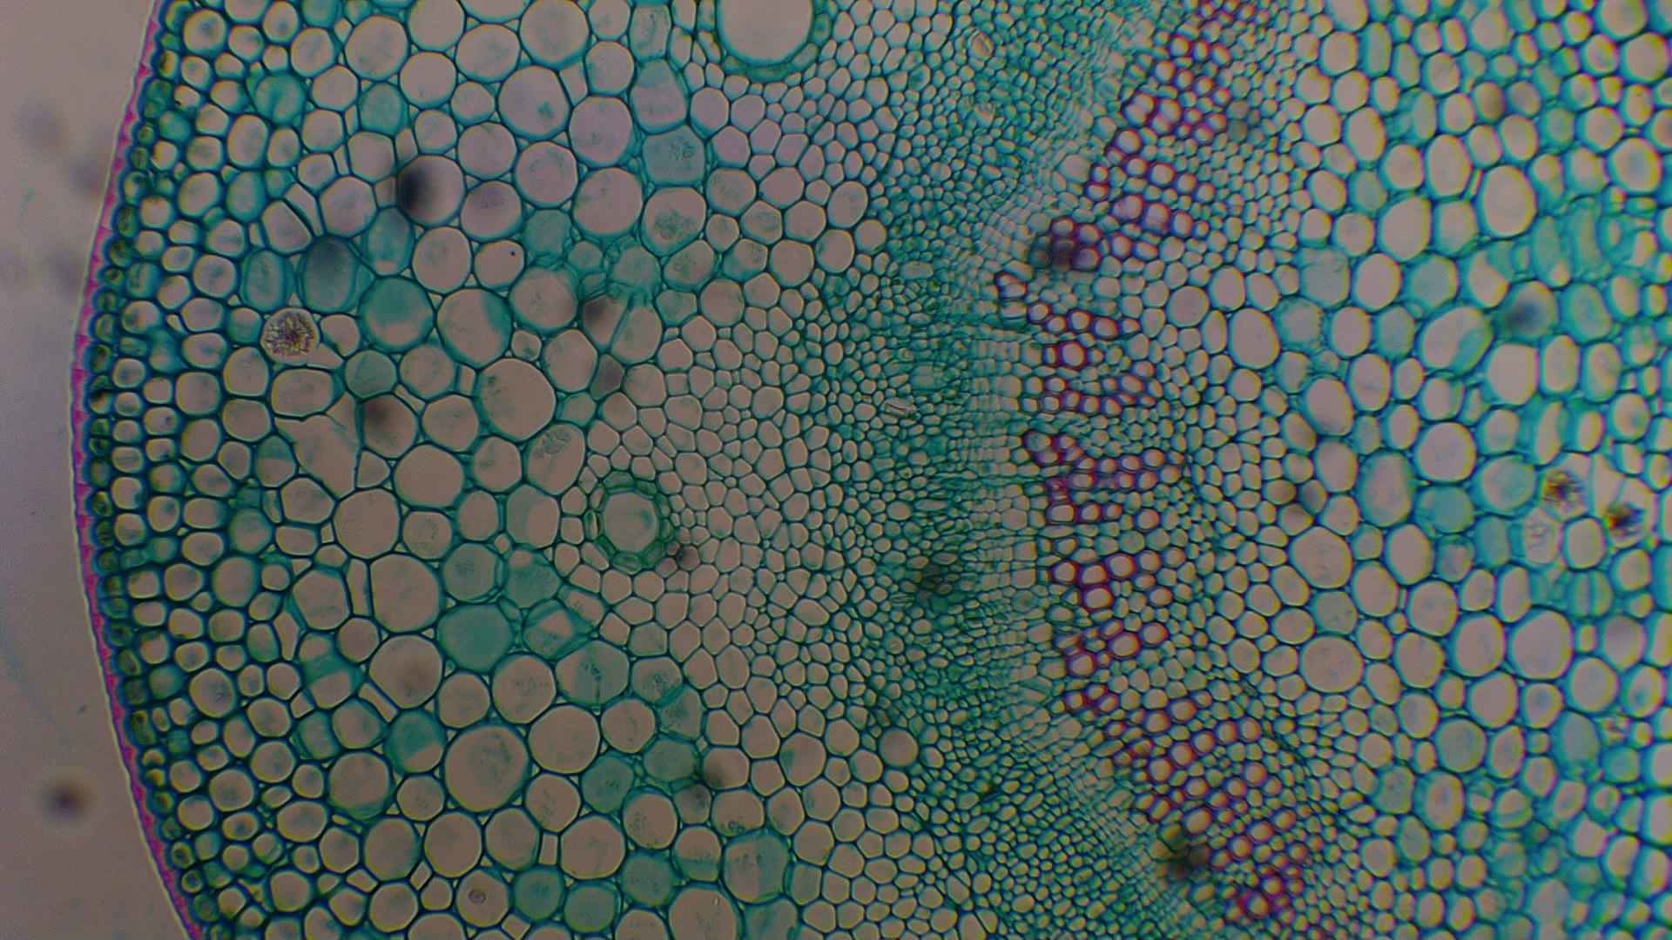
Omax microscope plant cells 100x

Slide 11
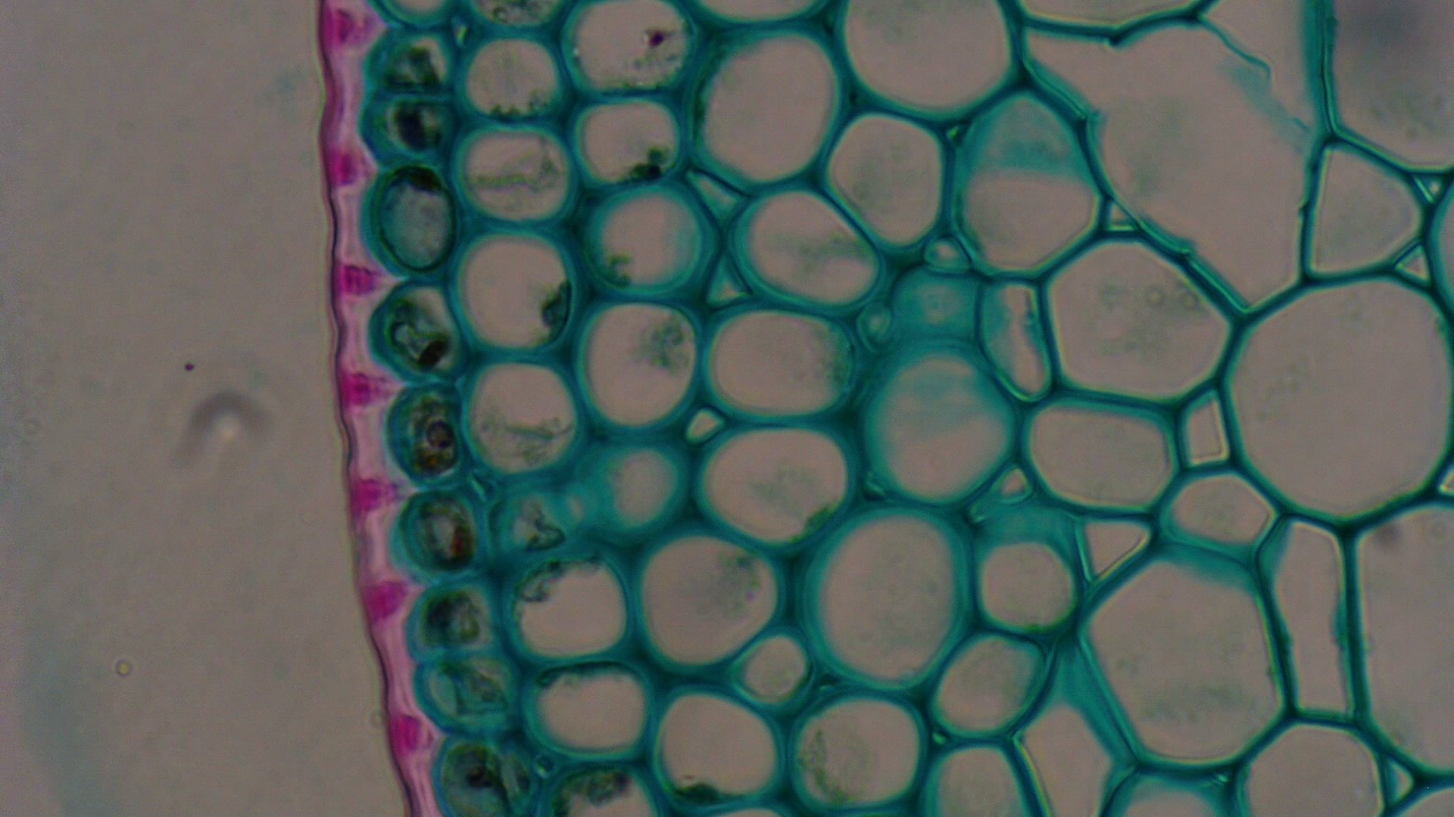
Omax microscope plant cells 400x

Slide 12
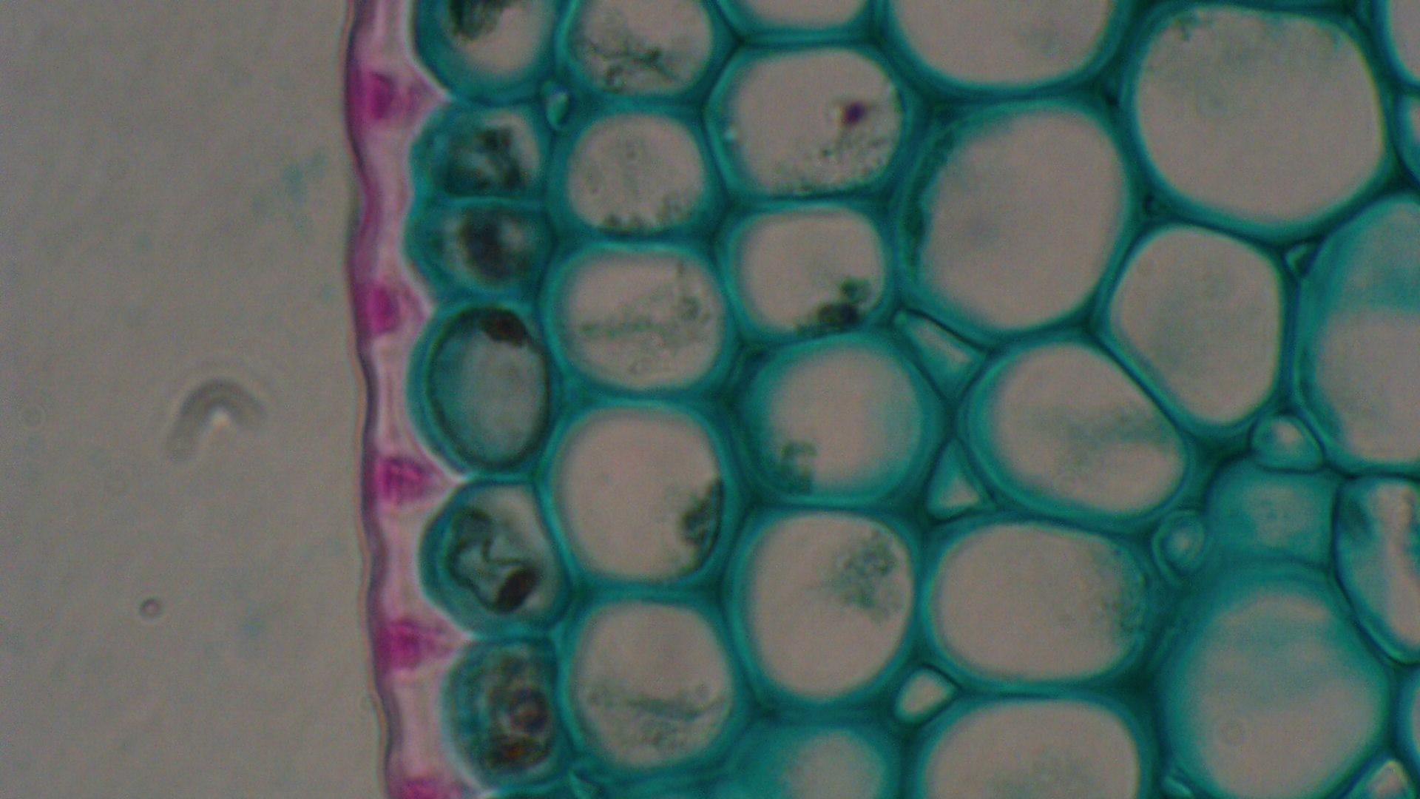
Omax microscope plant cells 400x

Slide 13
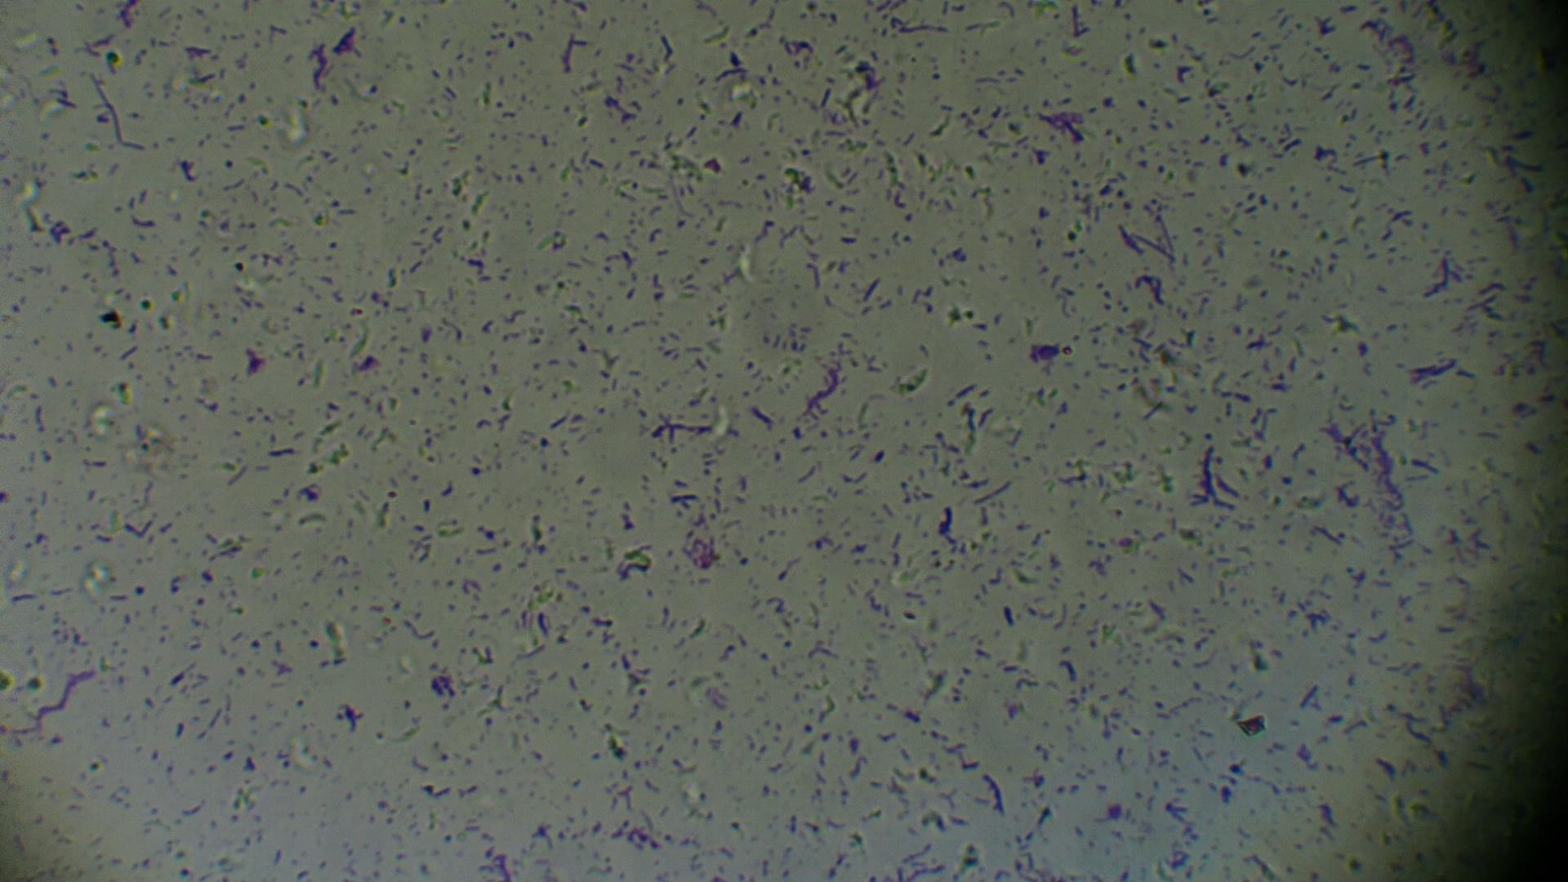
Omax microscope 3 bacteria 100x

Slide 14
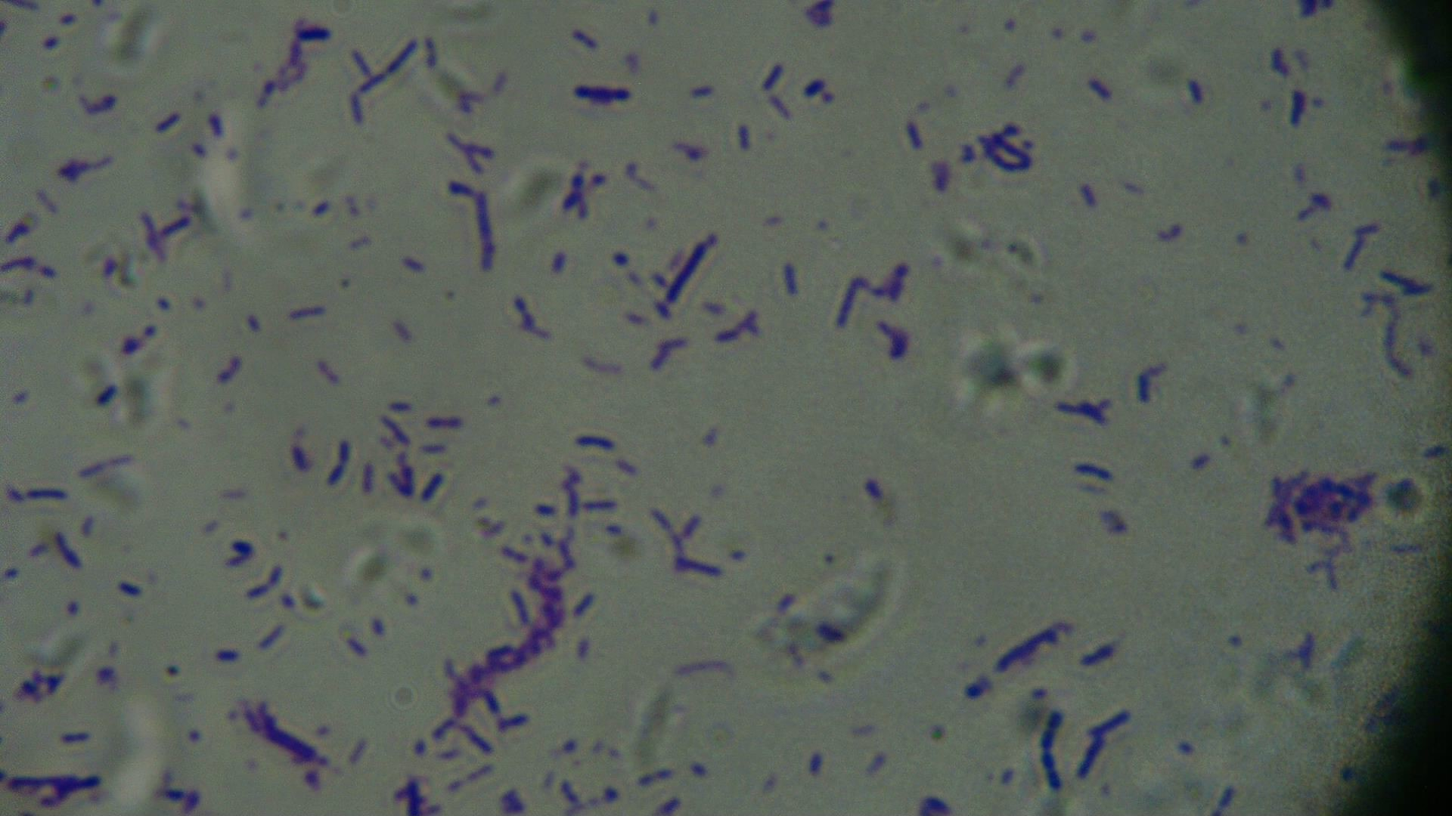
Omax microscope 3 bacteria 400x

Slide 15
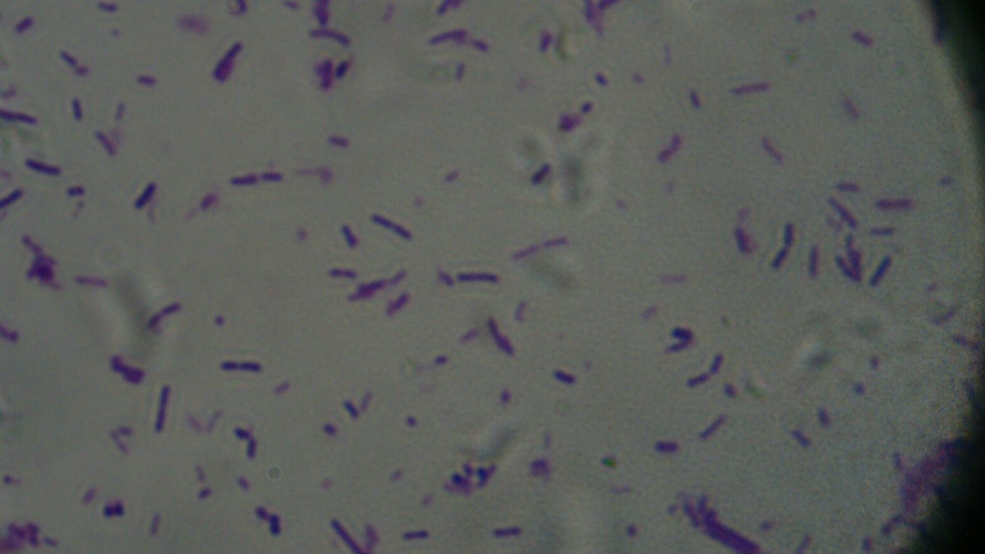
Omax microscope 3 bacteria 600x

